Slide 1
ACUTE NETRIN-1 RNA-SEQ · E18 RAT CORTICAL NEURONS
Acute Netrin-1 triggers a transient transcriptional program
A 5-minute Netrin-1 pulse activates an axon-guidance / projection program and suppresses RNA-processing & ribosome biogenesis — then returns to baseline by 15 min with r = −0.99 precision.
5 min
r = −0.99
313
0
main response window
5v0 vs 15v5 pathway mirror
5v0 significant GO BP terms
15v0 significant GO BP terms
Thesis defense

Slide 2
DEFENSE ROADMAP
A question-to-evidence arc, not a file-by-file tour
Five questions structure the talk; each is answered with a specific piece of evidence.
1
2
3
4
5
Background & gap
Design & QC
The 5-min response
Transient dynamics
Return to baseline
Netrin-1 is fast, local, guidance-related — is there an acute transcriptional layer?
9 RNA-seq samples, 0/5/15 min, replicate-aware modelling
Genes (Fos, Rock1) and a coordinated pathway program
IEG suppression, ROCK1 selectivity, pulse-like return
The r = −0.99 pathway mirror by 15 min
Acute Netrin-1 RNA-seq · cortical neurons · 0 / 5 / 15 min
02

Slide 3
BIOLOGICAL CONTEXT
Netrin-1 is classically fast, local and post-translational
Netrin-1 is a prototypical axon-guidance cue, steering the growth cone via DCC and UNC5 receptors.
Its canonical mechanism is post-translational and local — cytoskeletal remodelling, ROCK signalling, local translation.
It operates on a seconds-to-minutes timescale, so the field has focused on protein-level signalling…
…and largely overlooked the nucleus on this acute timescale.
CANONICAL NETRIN-1 SIGNALLING
Netrin-1
ligand cue
↓
DCC / UNC5
receptors
↓
Cytoskeleton · ROCK · local translation
effectors
↓
Growth-cone turning
seconds – minutes
Acute Netrin-1 RNA-seq · cortical neurons · 0 / 5 / 15 min
03

Slide 4
THE KNOWLEDGE GAP
The minute-scale transcriptional response is essentially uncharted
Almost all Netrin transcriptome studies sample hours to days — this study asks what happens in minutes.
0
5 min
15 min
1 h
hours – days
Vehicle
Netrin-1
Netrin-1
THIS STUDY
WHERE THE FIELD LOOKS
Acute 5 / 15 min time course — the uncharted minute-scale window.
Hours-to-days transcriptomic programs are well described; the acute nuclear response is not.
Acute Netrin-1 RNA-seq · cortical neurons · 0 / 5 / 15 min
04

Slide 5
THESIS QUESTION
Is acute Netrin-1 transcriptionally visible within minutes?
Three concrete sub-questions define the analysis.
Magnitude
Direction
Duration
Are there detectable genes or pathways after only 5 min?
Which biological programs go up, and which go down?
Does the response persist, or return toward baseline by 15 min?
WORKING HYPOTHESIS
Netrin-1 induces a fast, coordinated transcriptional response that is transient — small at the single-gene level but coherent at the pathway level — switched on, then off, rather than a stable reprogramming.
Acute Netrin-1 RNA-seq · cortical neurons · 0 / 5 / 15 min
05

Slide 6
EXPERIMENTAL DESIGN
A minimal acute time course: three conditions × three replicates
Nine RNA-seq samples; each replicate is neurons from an independent animal (true biological replicate).
Vehicle
Netrin-1
Netrin-1
PBS, 5 min · reference / 0 min
5 min
15 min
rep 1
rep 2
rep 3
rep 1
rep 2
rep 3
rep 1
rep 2
rep 3
Design limitation (stated up front): one shared PBS-5min control anchors both Netrin timepoints — there is no independent PBS-15min control. This confounds the 15-vs-0 contrast, so the main results rely on 5v0 and 15v5.
Acute Netrin-1 RNA-seq · cortical neurons · 0 / 5 / 15 min
06

Slide 7
ANALYSIS PIPELINE
From reads to pathways — DE on raw counts, batch correction for visuals only
Replicate is a model term in DE; limma batch correction is used only to make plots interpretable.
QUANTIFY
›
IMPORT
›
FILTER
›
MODEL
›
CONTRASTS
›
GSEA
DRAGEN Salmon
gene-level quant.genes.sf
tximport with
length offset → DESeq2
32,623 → 14,161
genes · 85.6% SYMBOL
~ replicate + timepoint
(ref = Vehicle)
Wald: 5v0 · 15v0 · 15v5
+ LRT over time
gseGO(BP) + gseKEGG
ranked by Wald stat
DIFFERENTIAL EXPRESSION
VISUALIZATION
Raw counts, with replicate as a blocking term in the model. Independent filtering kept on.
limma::removeBatchEffect (batch = replicate) applied only where explicitly plotted — never feeds the DE tests.
Acute Netrin-1 RNA-seq · cortical neurons · 0 / 5 / 15 min
07

Slide 8
STATISTICAL MODEL & SIGNIFICANCE
Replicate is the dominant variance source and is modelled explicitly
Model: ~ replicate + timepoint (reference = Vehicle).
Replicate (inter-animal) is the top variance source — PCA: replicate ≈ 52%, timepoint ≈ 34% — so it enters the model as a blocking factor.
Wald contrasts: 5v0, 15v0, 15v5. LRT (reduced ~ replicate) flags time-varying genes.
RELAXED = padj < 0.05. STRICT = padj < 0.05 & |log2FC| > 0.585 (FC > 1.5).
GSEA CONFIGURATION
Tool
clusterProfiler — gseGO(BP) + gseKEGG (rno)
Ranking
DESeq2 Wald stat, descending; entrez de-duplicated (max |stat|)
Gene set size
minGSSize 15 · maxGSSize 500
Significance
pvalueCutoff 0.05 · BH adjustment
WHY GSEA IS THE PRIMARY ANALYSIS
The acute signal is weak at the single-gene level. Aggregating thousands of ranked genes into pathways reveals the coordinated program that individual DEGs only hint at.
Stability
eps 0 · nPermSimple 10,000 · seed 123
Post-hoc
setSize ≥ 15 · GO simplify(cutoff 0.7)
Acute Netrin-1 RNA-seq · cortical neurons · 0 / 5 / 15 min
08

Slide 9
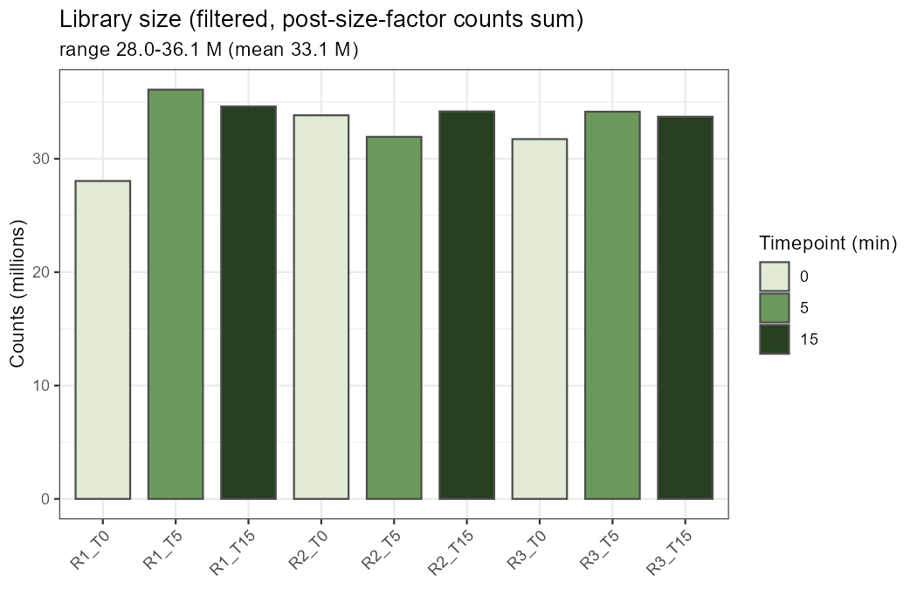
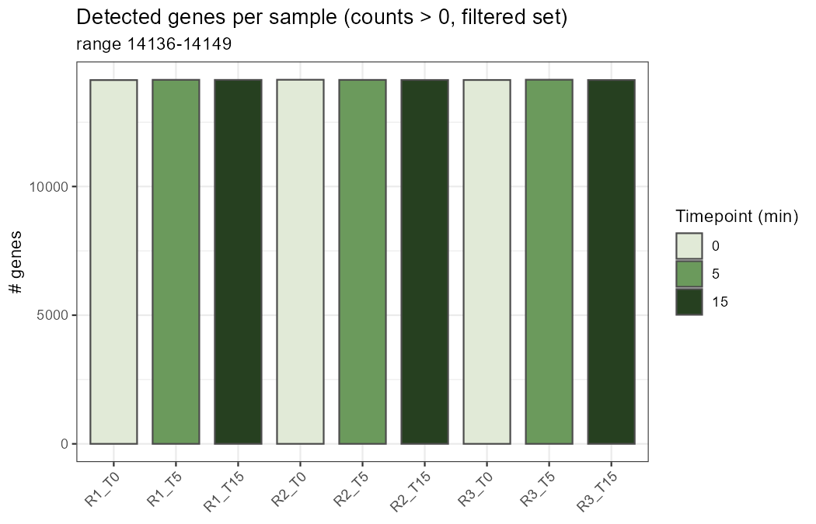
SEQUENCING QC
Library size and detected genes are comparable across all nine samples
No single sample drives the analysis through a sequencing-depth failure.
Filtered library size · mean ≈ 33.1 M
Detected genes · ≈ 14,136–14,149 per sample
Depth and gene-detection are uniform — downstream differences are biological, not technical artefacts of uneven sequencing.
Acute Netrin-1 RNA-seq · cortical neurons · 0 / 5 / 15 min
09

Slide 10
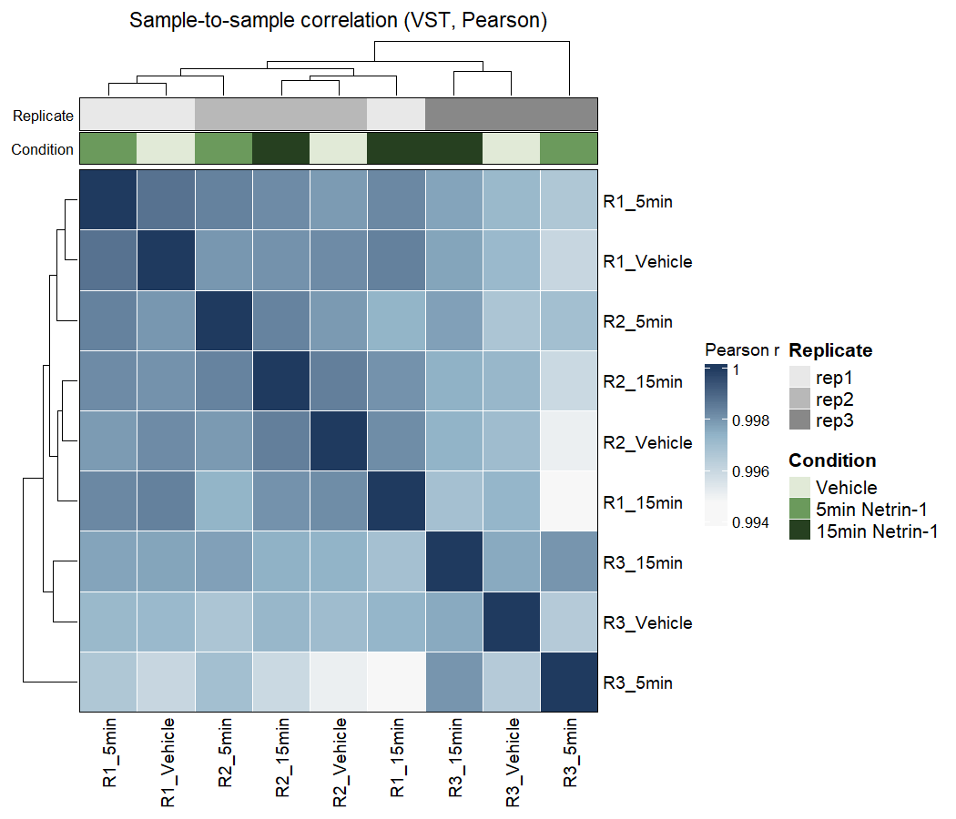
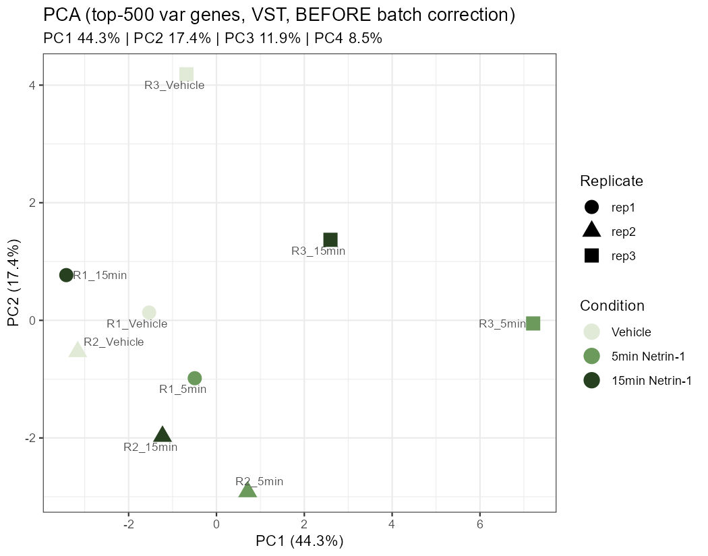
REPLICATE STRUCTURE
Biological replicate — not treatment — is the top axis of variation
This is why replicate enters the DE model as a blocking factor (DE still uses raw counts).
≈52%
top variance from
biological replicate
≈34%
variance from
timepoint
r = 0.995–0.999 between samples; R3_T5 mildly off but retained.
Sample correlation (VST, Pearson)
PCA before correction
Plots are exploratory visualisation only; differential testing uses raw counts.
Acute Netrin-1 RNA-seq · cortical neurons · 0 / 5 / 15 min
10

Slide 11
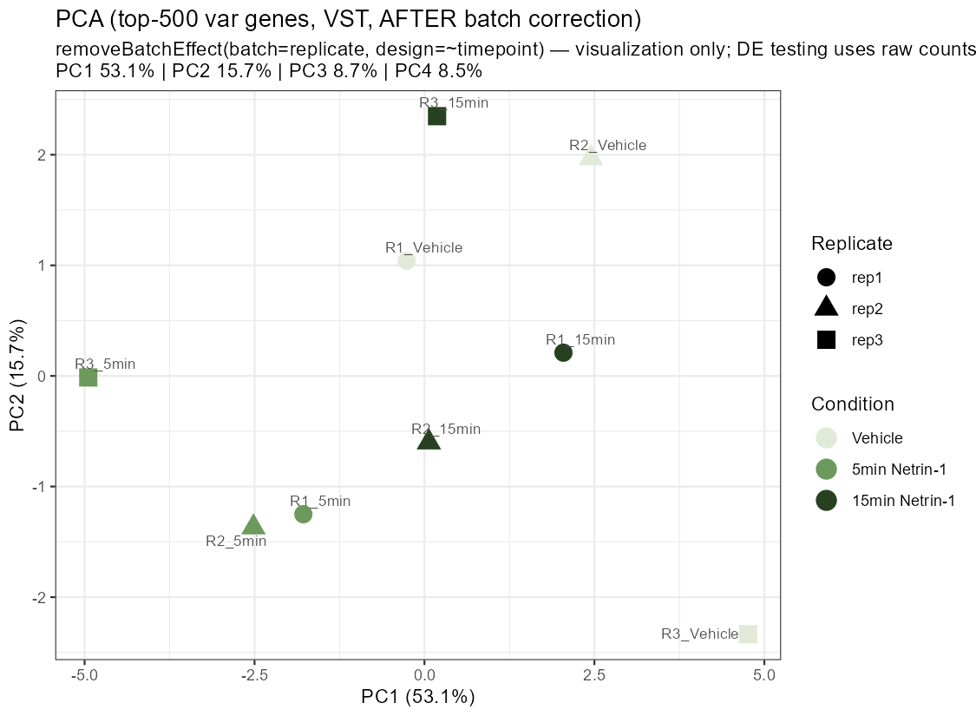
VISUALIZATION AFTER CORRECTION
Removing replicate effects reveals the expected timepoint axis
Batch correction is used here only to make the time structure visible — it does not prove the effect.
After correction
PC1 now separates the samples by 0 / 5 / 15 min, as expected for a treatment time course.
This supports — but does not replace — the replicate-adjusted DE model.
The key biological comparisons remain 5v0 (clean Netrin effect) and 15v5 (clean time evolution).
Acute Netrin-1 RNA-seq · cortical neurons · 0 / 5 / 15 min
11

Slide 12
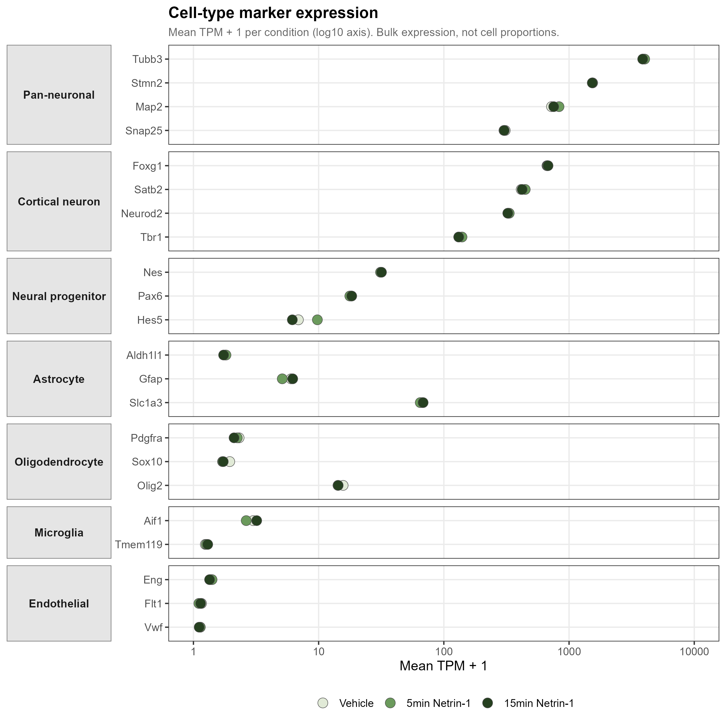
CULTURE COMPOSITION
Neuron-dominant cultures, stable across all three conditions
So downstream changes reflect a genuine transcriptional response, not a shift in cell-type proportions.
KEY READOUT
Pan-neuronal markers (Tubb3 ≈3900, Stmn2 ≈1540, Map2 ≈750 TPM) sit 2–4 orders of magnitude above glial / endothelial markers (Vwf, Flt1 ≈ 0.1).
Marker expression is near-identical across Vehicle / 5 min / 15 min.
Composition does not change — the acute signal is transcriptional, not compositional.
Acute Netrin-1 RNA-seq · cortical neurons · 0 / 5 / 15 min
12

Slide 13
ANALYSIS STRATEGY
Small at the gene level, coordinated at the pathway level — and acute
A modest DEG count is not a weak result when pathway ranks are coherent across thousands of genes.
32
5
313
14
5v0 RELAXED DEGs
5v0 STRICT DEGs
5v0 GO BP terms
5v0 KEGG pathways
WHERE THE SIGNAL SITS IN TIME
5v0
15v0
15v5
Netrin effect
time-confounded
time evolution
32 DEGs · 313 GO BP
1 DEG · 0 GO BP
6 DEGs · 295 GO BP
strongest
back to baseline
active reversal
Acute Netrin-1 RNA-seq · cortical neurons · 0 / 5 / 15 min
13

Slide 14
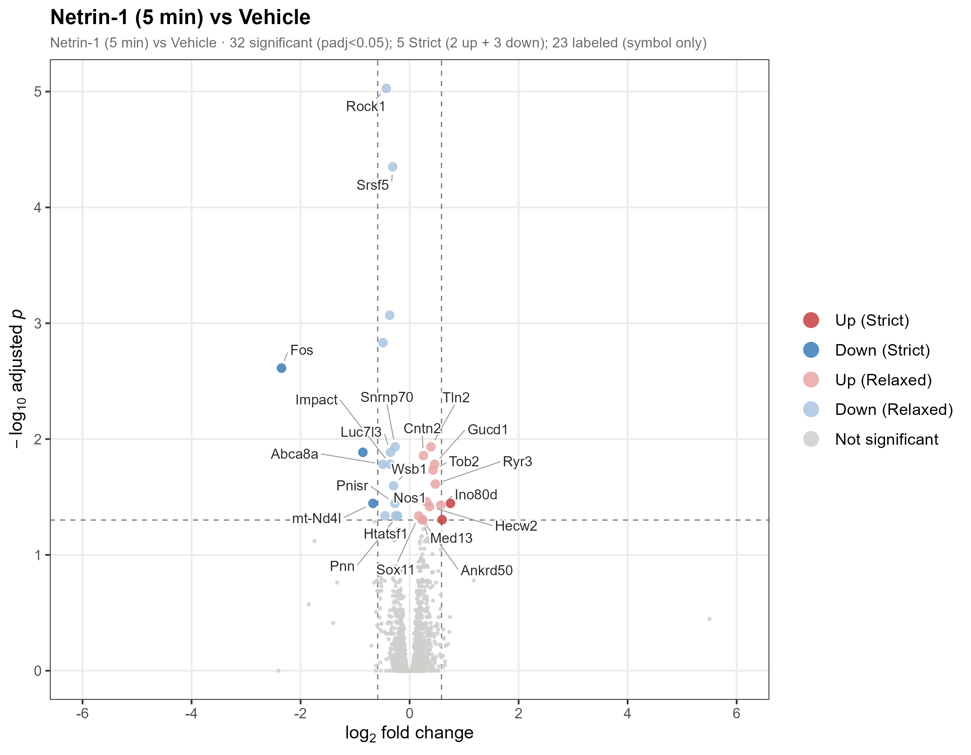
RESULT 1 · DEGS
The 5-minute response is real but focused
Few large switches; most effects are modest — exactly the profile that motivates pathway-level analysis.
5-vs-0: 32 RELAXED DEGs (14↑ / 18↓); 5 STRICT (2↑ / 3↓).
Fos is the standout — log2FC −2.35, padj 2.4e-3 — strongly down.
Most effect sizes are small, consistent with a fast, subtle, pathway-level signal…
…which motivates the GSEA analysis that follows.
Acute Netrin-1 RNA-seq · cortical neurons · 0 / 5 / 15 min
14

Slide 15
RESULT 1 · DEGS
Core 5-minute DEGs map onto coherent biological modules
Several modest log2FC values are highly significant because baseline expression is robust.
Gene | log2FC | padj | baseMean | Module
Fos | −2.35 | 2.4e-3 | 537 | Immediate-early gene ▼
Rock1 | −0.43 | 9.4e-6 | 2,812 | Cytoskeleton / ROCK ▼
Srsf5 | −0.31 | 4.5e-5 | 4,698 | Splicing ▼
Snrnp70 | −0.27 | 1.2e-2 | 7,932 | Splicing ▼
Cntn2 | +0.25 | 1.4e-2 | 15,129 | Axon guidance ▲
Nos1 | +0.32 | 3.5e-2 | 3,126 | NO–calcium ▲
Ryr3 | +0.47 | 2.4e-2 | 1,067 | NO–calcium ▲
Tln2 | +0.39 | 1.2e-2 | 1,888 | Adhesion ▲
Down at 5 min: IEG · cytoskeleton · splicing Up at 5 min: axon guidance · NO–calcium · adhesion
Acute Netrin-1 RNA-seq · cortical neurons · 0 / 5 / 15 min
15

Slide 16
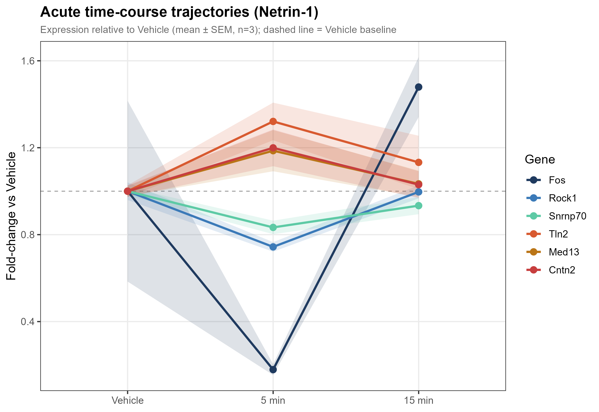
RESULT 2 · DYNAMICS
The response is a transient 5-minute pulse
LRT finds 19 genes changing over time; the dominant shape departs at 5 min and returns by 15.
Dominant pattern: deviate from baseline at 5 min, then return toward it by 15 min.
First direct evidence the program is transient, not sustained.
CAVEAT (SHOWN HONESTLY)
Fos overshoots baseline at 15 min, and its Vehicle replicates are variable — a wide error band. Interpreted cautiously.
Acute Netrin-1 RNA-seq · cortical neurons · 0 / 5 / 15 min
16

Slide 17
RESULT 2 · DYNAMICS
A surprise: two immediate-early genes are suppressed
Immediate-early genes are normally activated by neuronal activity. Here, acute Netrin-1 does the opposite — it acutely represses them.
▼ Fos
▼ Npas4
log2FC −2.35 · padj 2.4e-3
log2FC −1.75 · padj 0.076 (Wald, n.s.)
The strongest DEG of the whole study — strong, significant acute repression.
Significant by the time-course LRT — a second acutely-repressed IEG.
Together, Fos + Npas4 constitute an acute dual-IEG suppression — a novel observation for a guidance cue.
Acute Netrin-1 RNA-seq · cortical neurons · 0 / 5 / 15 min
17

Slide 18
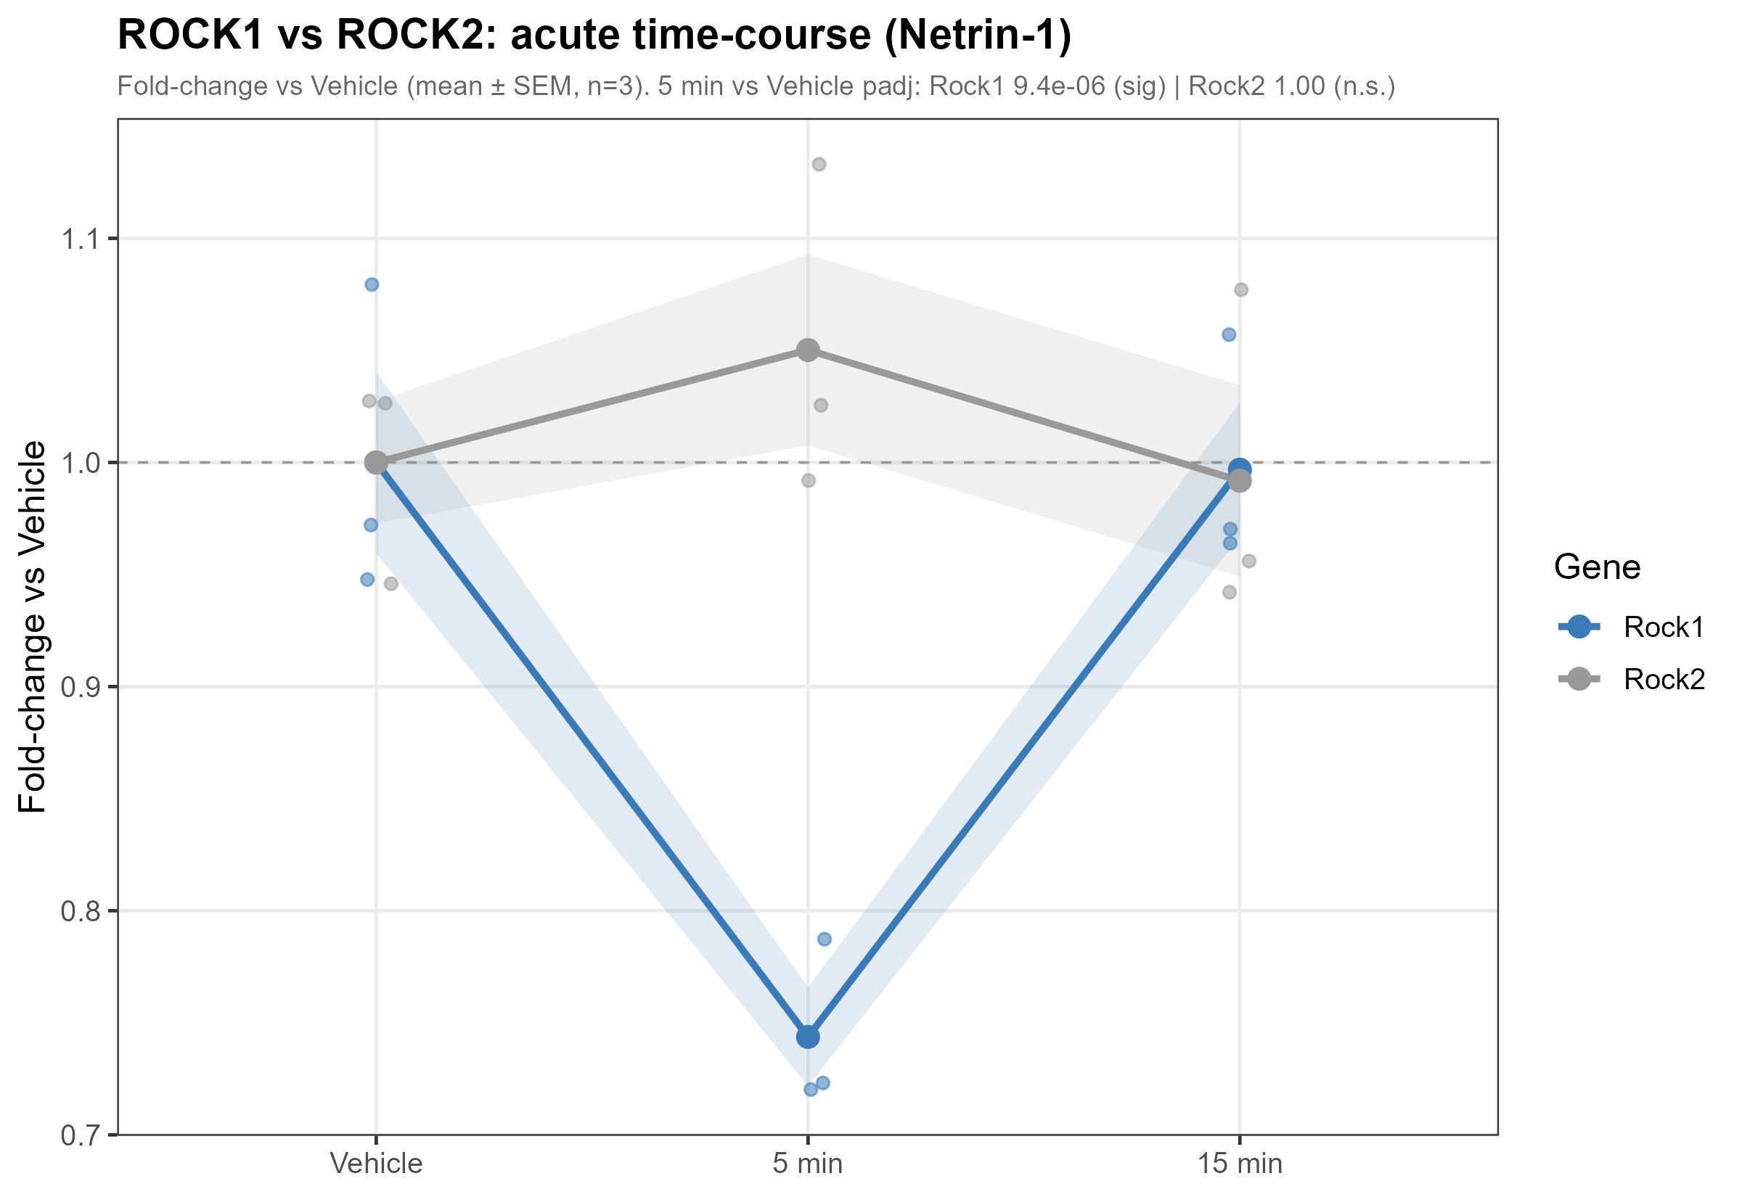
RESULT 2 · DYNAMICS
Selective control: Rock1 down, Rock2 untouched
Two paralogues, opposite fates within one cell — regulation is precise, not blunt.
Rock1 ▼ log2FC −0.43 · padj 9.4e-6
Rock2 log2FC +0.07 · padj 0.999 (unchanged)
ROCK1 is a classic downstream effector of Netrin–DCC signalling.
Implication: Netrin exerts isoform-selective transcriptional control.
Acute Netrin-1 RNA-seq · cortical neurons · 0 / 5 / 15 min
18

Slide 19
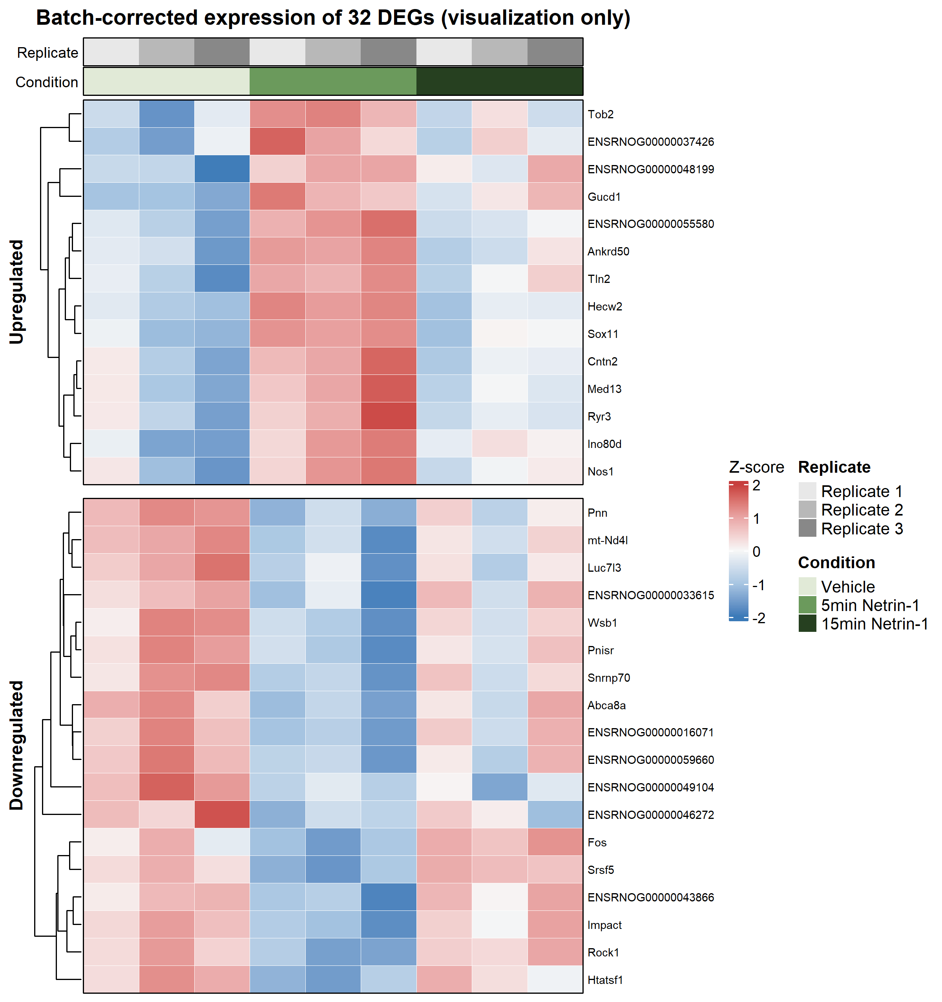
RESULT 2 · DYNAMICS
At the matrix level, the 5-minute state is a distinct, coherent program
Coordinated up- and down-blocks separate the Netrin-5min condition — not scattered noise.
Heatmap of the 32 5-vs-0 DEGs across all nine samples (batch-corrected for visualisation only).
Clear up- and down-regulated blocks distinguish the 5-minute condition.
Patterns are consistent within replicates after batch handling.
Confirms the 5-minute state is a distinct, coherent program rather than a few noisy genes.
Acute Netrin-1 RNA-seq · cortical neurons · 0 / 5 / 15 min
19

Slide 20
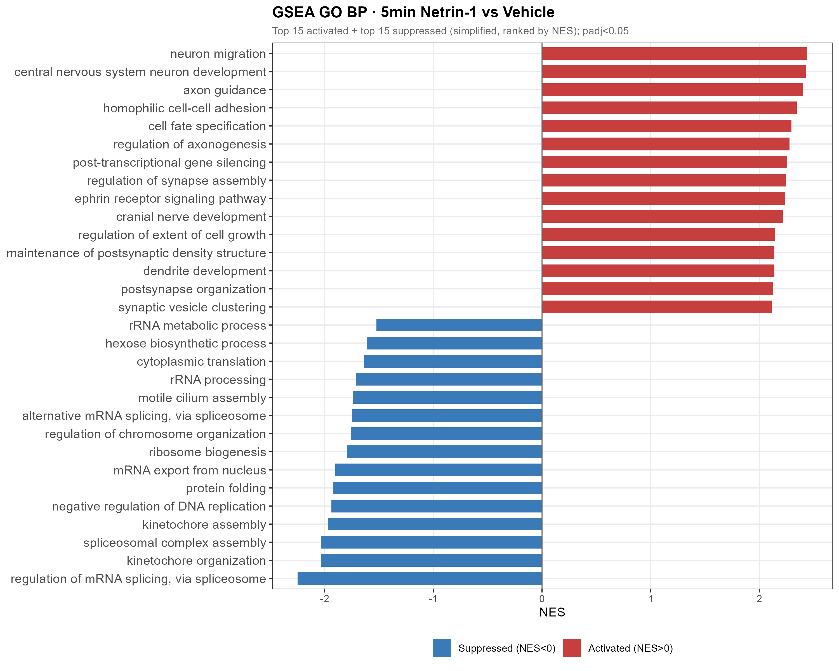
RESULT 3 · PATHWAYS
GSEA reveals a coordinated genome-wide program at 5 min
The strongest evidence is coherent ranking across hundreds of biological processes.
313 significant GO BP terms (285↑ / 28↓)
▲ Activated
axon guidance · neuron projection · synapse assembly
▼ Suppressed
mRNA splicing / processing · ribosome biogenesis · translation
Acute Netrin-1 RNA-seq · cortical neurons · 0 / 5 / 15 min
20

Slide 21
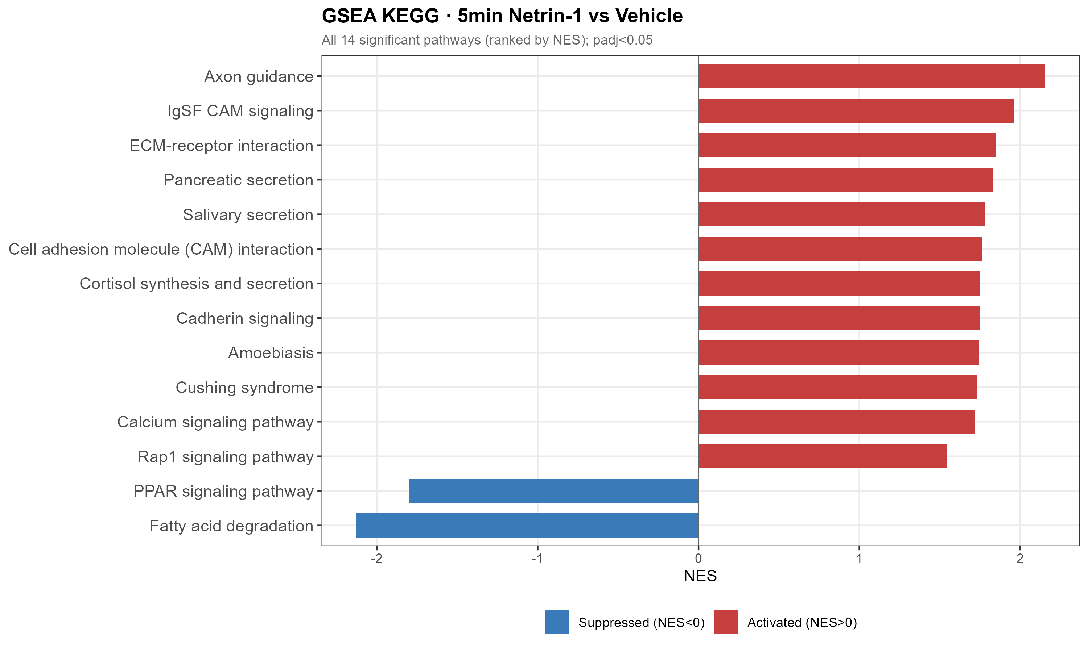
RESULT 3 · PATHWAYS
Axon guidance is the top KEGG pathway in the acute response
Netrin's canonical protein-level function is mirrored at the transcriptional level — within 5 min.
TOP KEGG SIGNAL
Axon guidance
NES 2.16 BH p = 4.1e-7
14 significant KEGG pathways; includes the parallel ephrin guidance system.
Transcription runs in parallel with the classic post-translational mechanism — not merely after it.
Acute Netrin-1 RNA-seq · cortical neurons · 0 / 5 / 15 min
21

Slide 22
PROGRAM ARCHITECTURE
The 5-minute response is bidirectional, not a generic activation signature
Guidance-related programs rise while RNA-processing and biosynthetic machinery fall.
▲ UP at 5 min
▼ DOWN at 5 min
Neuron projection guidance
Axon guidance
Synapse assembly
Cell adhesion / IgSF CAM signalling
NO–calcium signalling
mRNA processing
mRNA splicing
Ribosome biogenesis
Translation-related programs
Immediate-early genes (Fos, Npas4)
Acute Netrin-1 RNA-seq · cortical neurons · 0 / 5 / 15 min
22

Slide 23
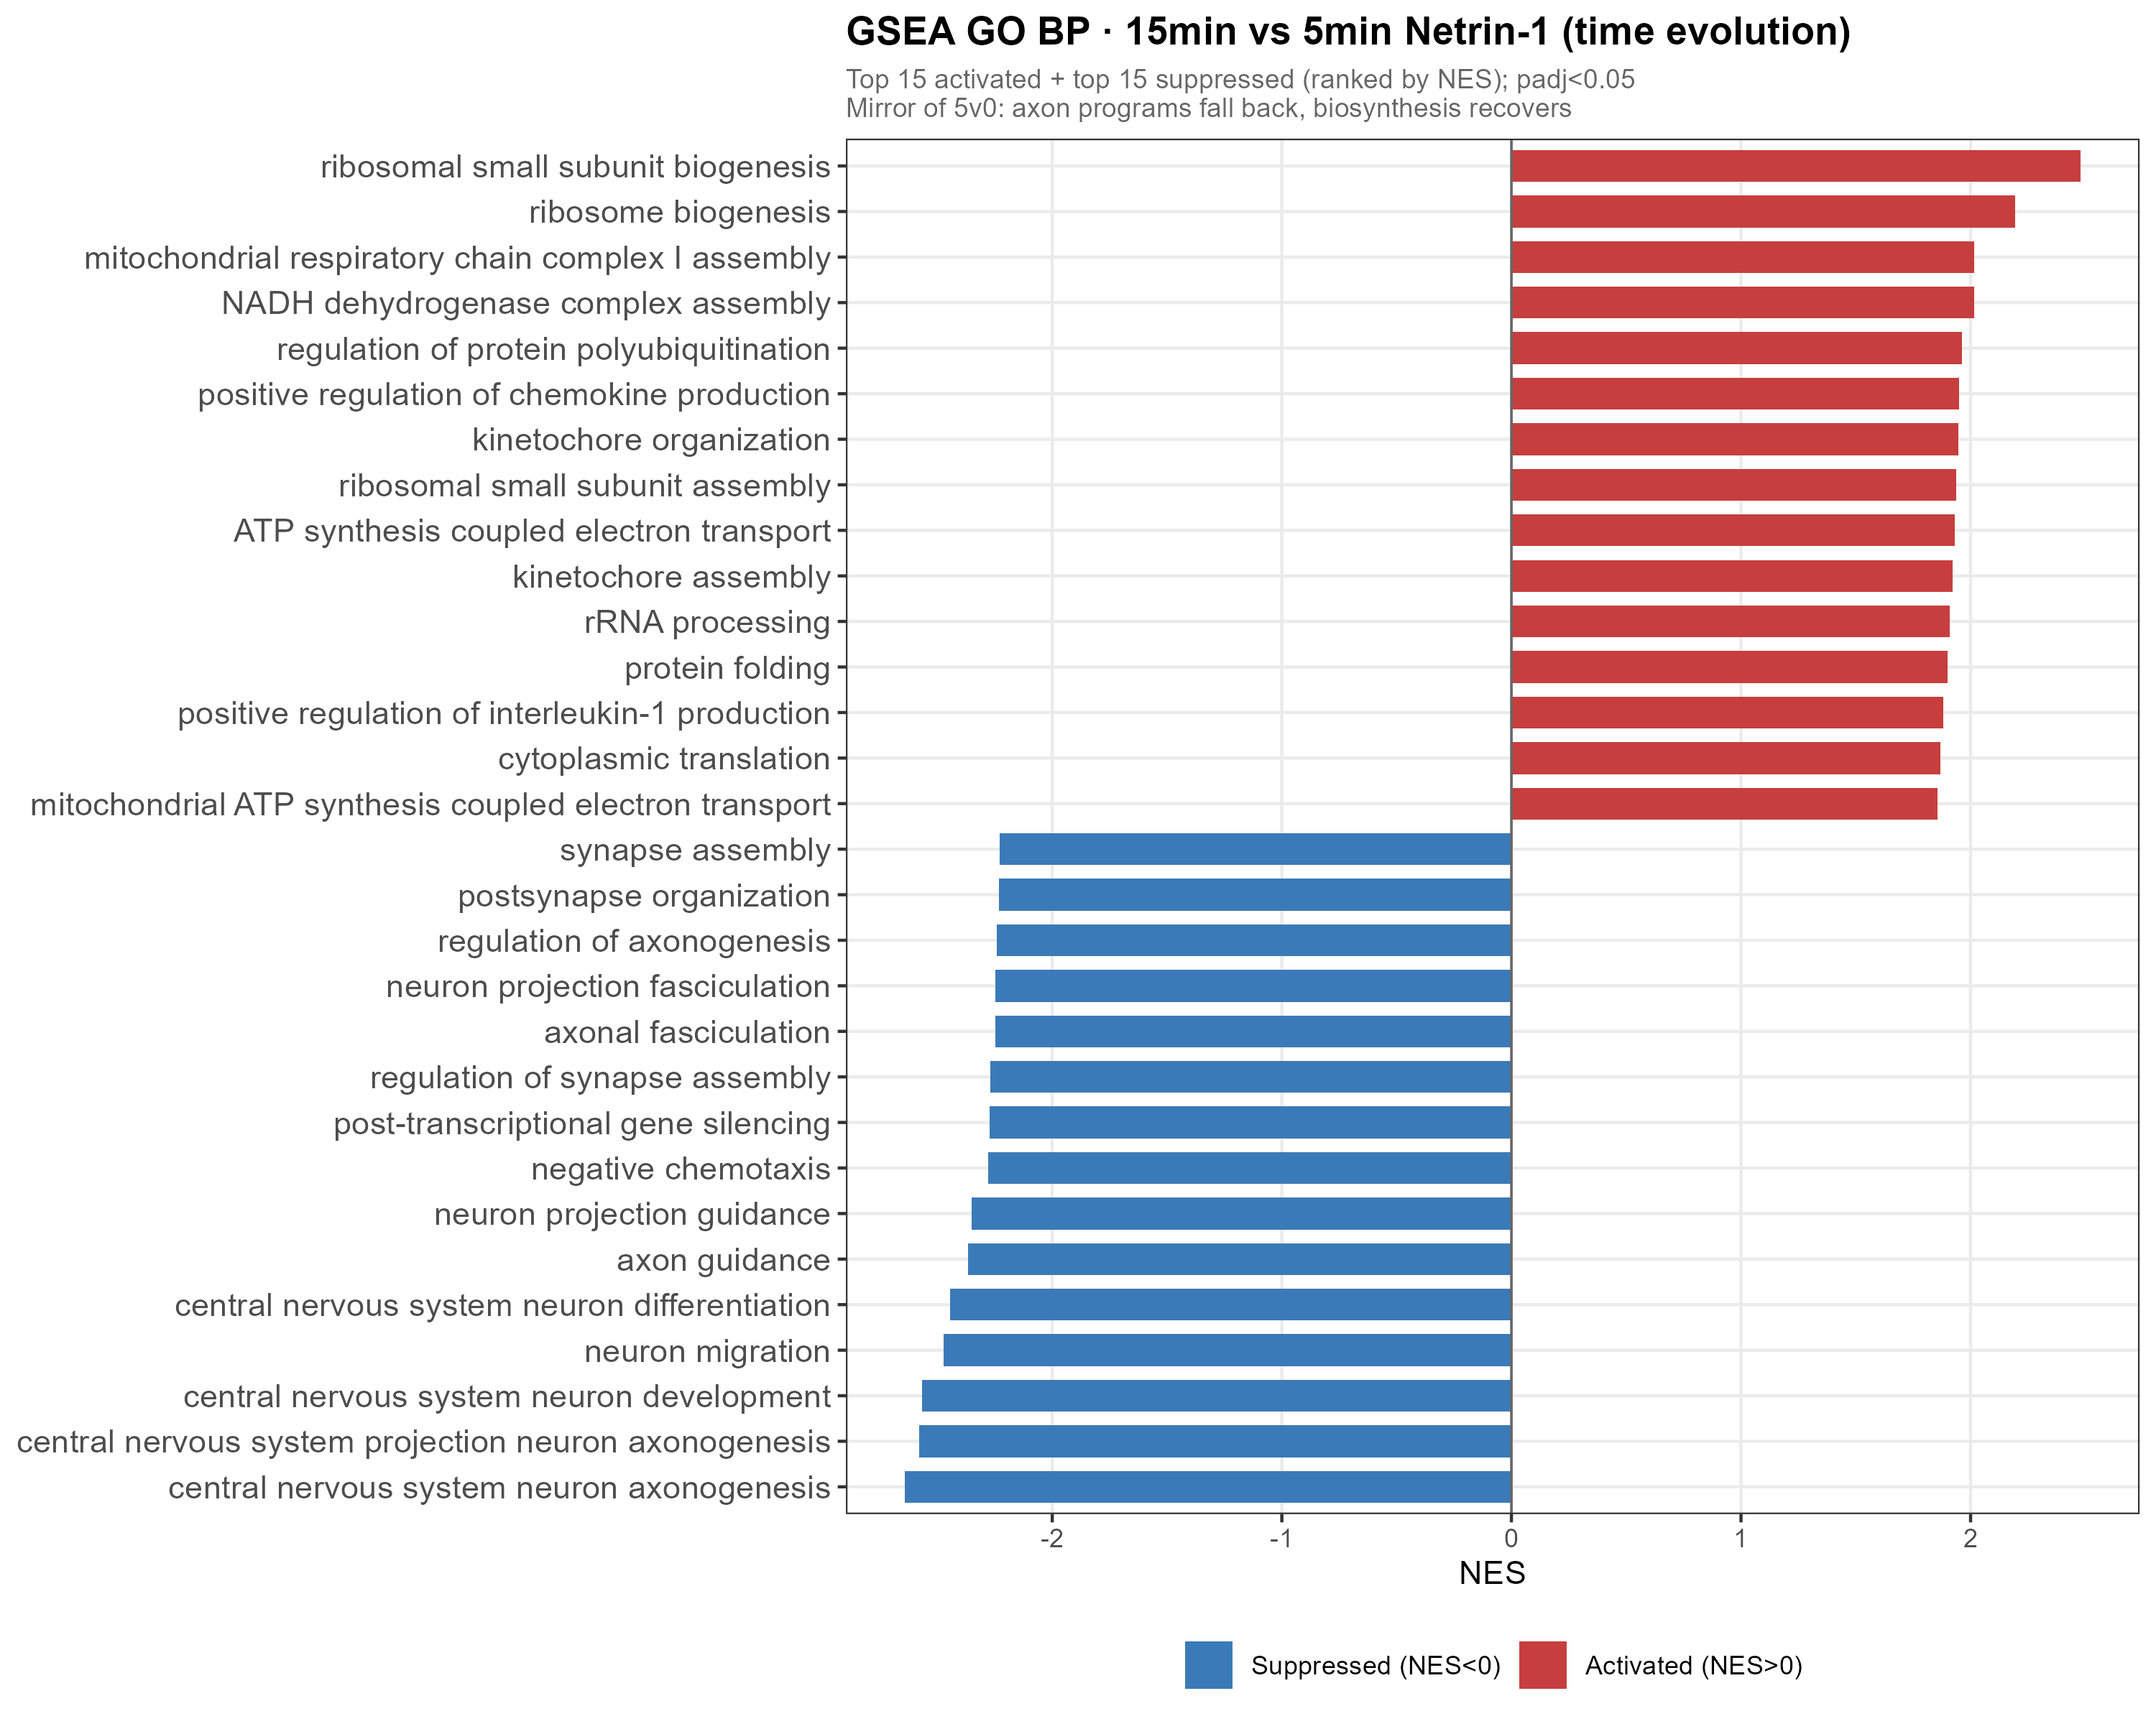
RESULT 4 · RETURN
By 15 min the 5-minute program is directionally flipped
The 15-vs-5 contrast asks whether the acute state is actively reversed — it is.
295 significant GO BP terms (31↑ / 264↓)
Direction is flipped versus 5v0: axon-guidance terms now fall, biosynthesis terms recover.
15v0 GO BP: 0 significant terms — by 15 min the transcriptome is back at baseline.
The program is switched on at 5 min and off by 15.
Acute Netrin-1 RNA-seq · cortical neurons · 0 / 5 / 15 min
23

Slide 24
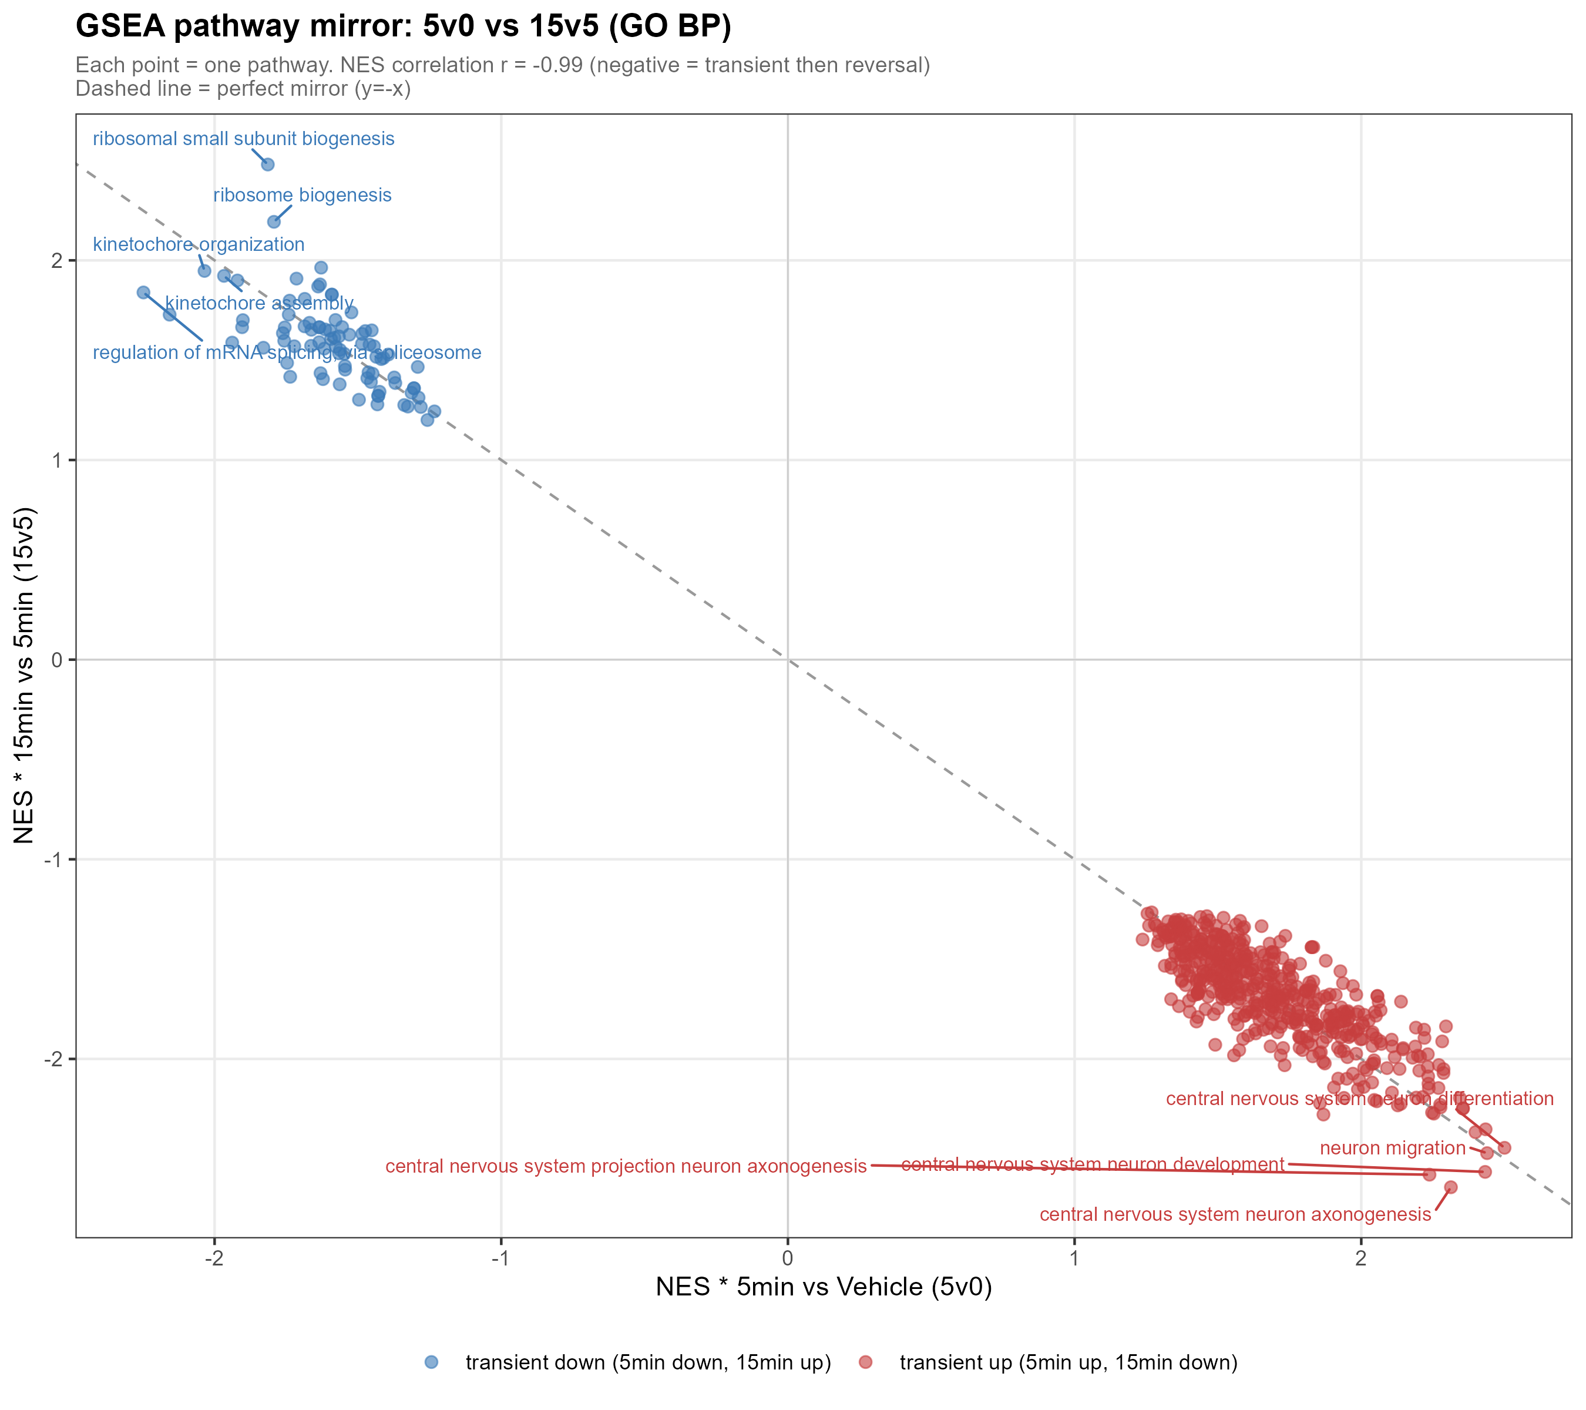
RESULT 4 · RETURN
The signature result: a near-perfect r = −0.99 mirror
r = −0.99
5v0 vs 15v5 pathway NES correlation
603 pathways shared between 5v0 and 15v5.
Their enrichment scores are near-perfect opposites.
Every pathway activated at 5 min is suppressed by almost exactly the same amount from 5→15 min.
Quantitative proof the 5-minute program is precisely undone — a true transient.
24

Slide 25
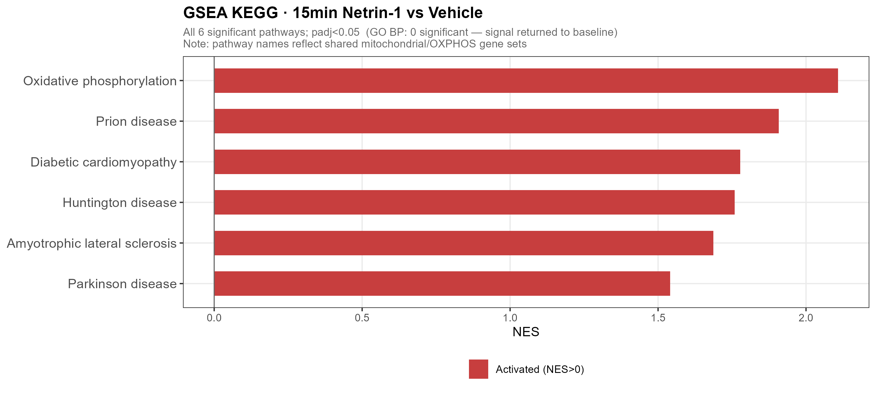
RESULT 4 · RETURN
A late, secondary signal: mitochondrial OXPHOS
At 15 min a mild up-regulation of OXPHOS / NADH-dehydrogenase genes emerges, after the main program.
INTERPRETATION CAVEAT
KEGG labels these as 'Prion / Huntington / Parkinson' disease pathways — but those share the same mitochondrial genes.
Read as OXPHOS up-regulation, not disease biology.
GO BP: 0 significant terms · KEGG: 6, OXPHOS-led.
15-min KEGG vs Vehicle — disease names index shared mitochondrial / OXPHOS genes.
Acute Netrin-1 RNA-seq · cortical neurons · 0 / 5 / 15 min
25

Slide 26
INTEGRATED EVIDENCE
Multiple result layers converge on one transient program
Module | 5 min | by 15 min | Evidence
Axon guidance / projection | ▲ up | falls back | GO BP · KEGG · Cntn2
RNA processing / splicing | ▼ down | recovers | Srsf5 · Snrnp70 · GO BP
Ribosome / translation | ▼ down | recovers | GSEA · 15v5 mirror
Immediate-early genes | ▼ down | rebound | Fos · Npas4 (LRT)
Cytoskeleton / ROCK | ▼ down | recovers | Rock1 (Rock2 n.s.)
NO–calcium / adhesion | ▲ up | falls back | Nos1 · Ryr3 · Tln2
Mitochondria / OXPHOS | — flat | late rise | 15v0 / 15v5 KEGG
PROPOSED MODEL
0 MIN
›
5 MIN PULSE
›
15 MIN
Vehicle
baseline
guidance / projection ▲
biosynthesis & IEGs ▼
reversal — 15v5 mirrors 5v0
back to baseline
Acute Netrin-1 RNA-seq · cortical neurons · 0 / 5 / 15 min
26

Slide 27
DISCUSSION
Five take-home messages
1
Dual IEG suppression
Fos and Npas4 are both acutely down-regulated — opposite to the canonical activity-induced behaviour of IEGs. A novel observation.
2
Coordinated biosynthesis shutdown
Splicing + ribosome biogenesis + translation are transiently suppressed together — possibly reallocating resources toward local translation.
3
Guidance program — transcriptional arm
Axon guidance is induced at the mRNA level within minutes, running in parallel with Netrin's classic post-translational mechanism.
4
r = −0.99 transient reversal
A near-perfect mirror: the 5-min program is precisely undone by 15 min. The study's strongest quantitative result.
5
ROCK1-selective control
Rock1 down, Rock2 unchanged — isoform-specific regulation of a canonical Netrin–DCC effector.
Acute Netrin-1 RNA-seq · cortical neurons · 0 / 5 / 15 min
27

Slide 28
LIMITATIONS & NEXT STEPS
Strongest conclusions are pathway-level and temporal — with clear design boundaries
LIMITATIONS — READ HONESTLY
NEXT EXPERIMENTS
n = 3, and the acute signal is weak — GSEA / pathway level is the primary analysis.
No independent PBS-15min control — 15v0 confounds treatment with time; main results use 5v0 & 15v5.
Only three timepoints — dynamics from LRT + trend classification, not dense time-series modelling.
Fos shows high Vehicle-replicate variability — wide error band.
Bulk RNA-seq, not single-cell — markers reflect overall expression, not cell-type proportions.
Dense time course (0/2/5/10/15/30 min) to map the full pulse shape, with per-timepoint controls.
Perturb DCC / UNC5 (blockade or knockdown) to test receptor-dependence of the pulse.
ROCK1 protein, phospho-signalling and cytoskeletal readouts after acute stimulation.
Single-cell / sorted-neuron validation to localise the response within culture heterogeneity.
Link the transient transcriptional swing to local translation at the growth cone.
Acute Netrin-1 RNA-seq · cortical neurons · 0 / 5 / 15 min
28

Slide 29
CONCLUSIONS
Acute Netrin-1 triggers a rapid, coordinated and transient transcriptional program in cortical neurons — reversed to baseline with r = −0.99 precision within 15 minutes.
First characterization of Netrin-1's minute-scale transcriptional response.
Transcription runs in parallel with the classic post-translational mechanism.
Novel findings: dual-IEG suppression (Fos + Npas4) and ROCK1-selective regulation.
The r = −0.99 mirror defines a precisely-controlled transient — not reprogramming.
Thank you
A 5-minute Netrin-1 pulse switches a coordinated transcriptional program ON — then OFF again by 15 min, with r = −0.99 precision.
29

